Slide 1
Why Care About Deduplication?
Cross Duplication between training/alignment and evaluation skews testing
Some “standard” benchmarks are widely duplicated in web and scientific text [https://arxiv.org/pdf/2403.00393.pdf]
Leaking can “improve” model performance by 8-11% [https://arxiv.org/pdf/2402.02823.pdf]
Too much duplication leads to memorization
Memorization can have negative impacts on generalization
Memorization has serious copyright implications [AI Meets Copyright: Understanding New York Times v. OpenAI | The Federalist Society]
Data privacy is at risk
Memorization can have negative trust and safety implications too
Offers precise control over the training distribution of our model
Importance resampling has been applied to great success in GPT-style models by OpenAI [https://arxiv.org/abs/2005.14165]
Credit: Robert Underwood
runderwood@anl.gov

Slide 2
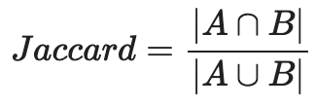
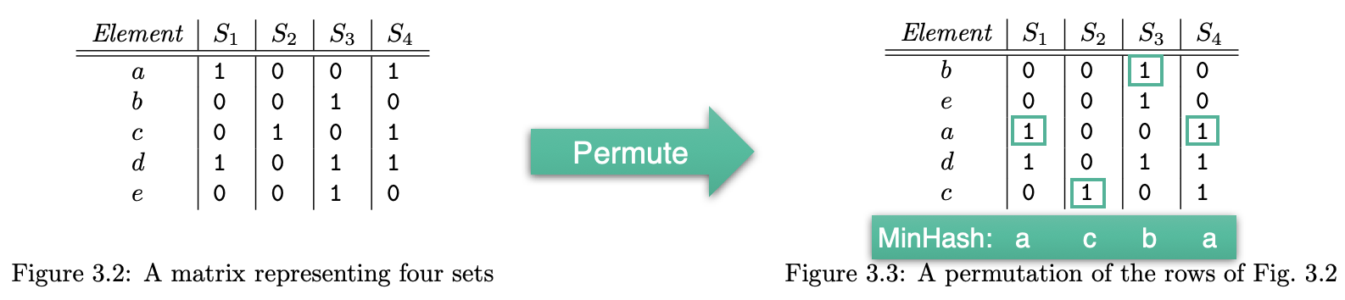
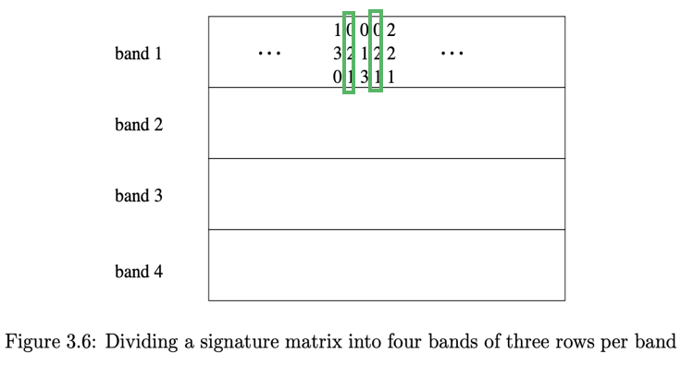
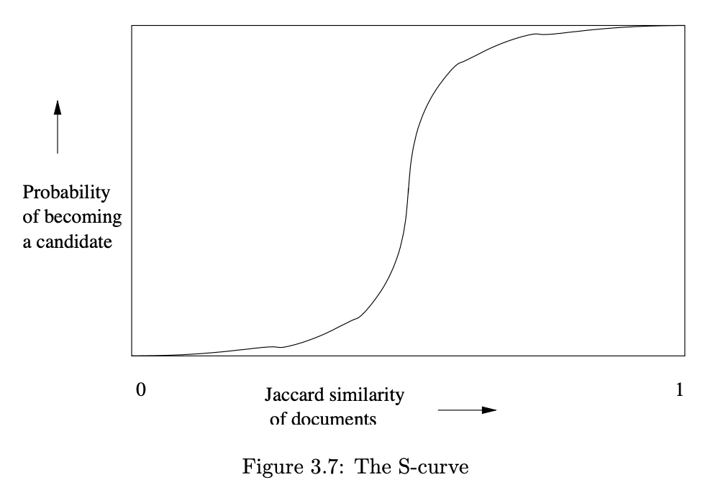
MinhashLSH
Fundamentals:
Treat documents as sets of n-grams
Find duplicates by estimating Jaccard Similarity (set overlap)
To avoid pair-wise comparisons (O(n²)), apply LSH function to get candidate pairs of duplicates

Slide 3
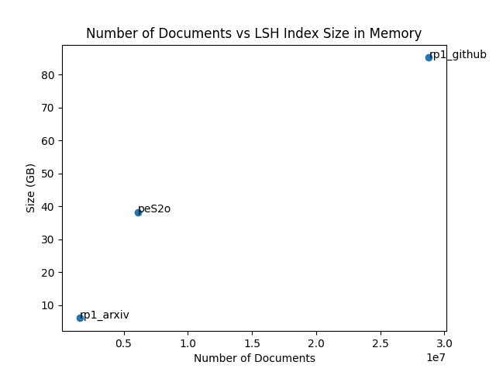
But what if we absolutely need to process billions of documents?
LSH results can be stored in an index, usually as a prefix-tree or a table for efficient lookup, but this scales poorly in the number of documents we have.

Slide 4
This Simply Does Not Work
Extrapolating, a dataset of 10 billion documents will result in an index that is approximately 16.67 Terabytes.
One node on Polaris has 512 GB of RAM, we would need 32 nodes just to load up an index of this size!!!
The local SSD size of a node on polaris is 3.2 Terabytes, to hold the index on local disk we would need atleast 6 nodes!!!
Notes:
You’re gonna page fault bro

Slide 5
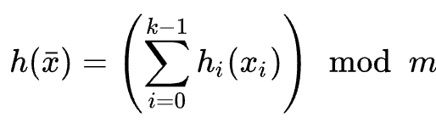
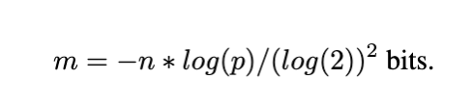
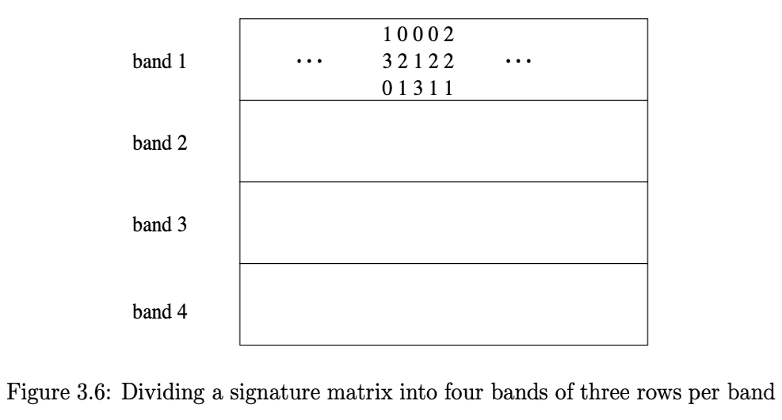

MinhashLSH + BloomIndex
We can replace the LSHIndex with a series of Bloom Filters!
Traditional MinhashLSH index size on 10 Billion Documents: 16.67 Terabytes
BloomIndex: 130 Gigabytes!!!
128x Size Reduction!!!

Slide 6
Integrating Bloom Filters into MinhashLSH
We can replace the LSHIndex with a series of Bloom Filters!
Benefits
Given set size and desired FP probability, we can guarantee optimal space usage
Extremely small indices
Gives us (virtually) the same probabilistic guarantees as using traditional MinhashLSH
Drawbacks
Additional false positive probability as overhead (in practice, fp=0.001)
We can’t identify duplicate pairs, only duplicates

Slide 7
Optimizing our Pipeline
Parallelization
Filter Construction from many corpora in parallel
Exploring Bloom Filter Variants
Cuckoo Filter, Big Friendly Filter
Getting back duplication metadata to find duplicate pairs
Implementing space-efficient associative arrays with bloom filters

Slide 8
Handling Multi-Modal Data
Image/Video
Semantic comparisons of image content using vision model embeddings
What invariants should we support? Rotation, translation, warps, etc?
Patching analogous to how we use n-grams?
Ingesting Tablature
Should we treat this as text, or as a structured data form of its own?
Raw Scientific Data
Application specific visualizations, plots, data formats
How should application-specific requirements inform our approach to preprocessing?
Equivariant Neural Networks for physics/chemistry data?
Ingesting trajectories using sequence models?
Particle data (e.g., HACC)
Molecular data (e.g., NWCHEM)
Code
We want to capture the rich semantic content here
Can we take advantage of the inherent tree structure here?

